Slide 1

Datathon 2023

Slide 2
Schedule
12-12:30 Team forming and intro talk.
12:30 Kickoff + Pizza!
12:30 - 6:00 Get data-ing!
4 Test set released
6:00 Submission deadline, then more pizza + presentations
7:30 Final announcements!
8 Celebrate

Slide 3
Task
Our dataset is about road accidents.
We want you to:
Predict the casualty_severity of individuals.
NOTE - We want you to do this for new accidents, not ones that have already occurred (important distinction).

Slide 4
Beginner Data Runthrough
Will only use the casualty and vehicle tables
Check README and reference spreadsheet for a more detailed description of data.
Aim to predict ‘casualty_severity’ in the casualty data, mapping the current values as described in the README.
Not necessary to use both, if you are struggling just use the casualty data!
Build the best predictive model, bonus points for creative solutions and good understanding of the data.

Slide 5
Advanced Data Runthrough
Working with a dataset spread over 3 csvs: casualty, vehicle and accident.
Requires a little bit of thought/data engineering
Need to do a bit of data engineering to put it all in one
Or figure out how to make your model work on this more diverse dataset.
Includes geospatial and time data too.
Will need to present any insights you generate, with an emphasis on visualisations. This will be more in depth than the beginners.

Slide 6
Prizes!
Performance Prize - Beginner £100 Advanced £100
For the best performance in our custom metric on the next slide
Presentation and Understanding Prize - Beginner £50 Advanced £150
We will judge this from the presentations you give. We’re looking for understanding of what’s going on! We have put more emphasis on the presentation skills for the advanced section, as this is what you’ll be doing in the workplace!
Creativity Prize - Beginner £50 Advanced £50
For the teams that approach the problem in the most creative way. This could be some very clever feature selection and data processing, or an exciting machine learning technique you’ve implemented.
One prize per team max
Prizes can be distributed however you want within the teams

Slide 7
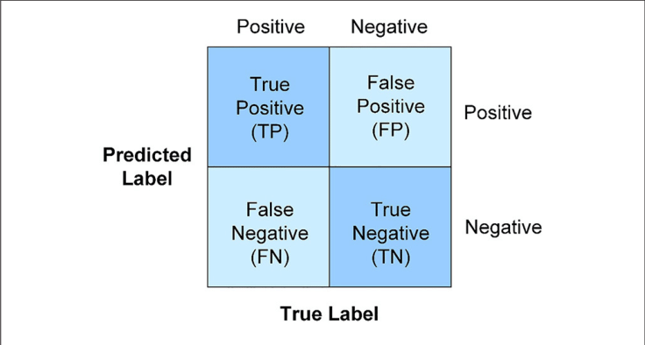
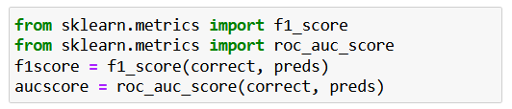
Scoring (How to win)
Best Performance: (ROC + F1 score)/2
These can be found using sklearn with:
from sklearn.metrics import f1_score
from sklearn.metrics import roc_auc_score
f1score = f1_score(correct, preds)
aucscore = roc_auc_score(correct, preds)
Presentation: A 3-5 Minute spoken/powerpoint presentation of your results, methods, and the MEANING of your results. Which variables were not correlated, which ones were best predictors. Pretty graphs highly encouraged.

Slide 8
Rules
Be kind!
NO FOOD OR DRINK IN THE COMPUTER ROOM.
If it feels like cheating, it’s cheating

